Slide 2
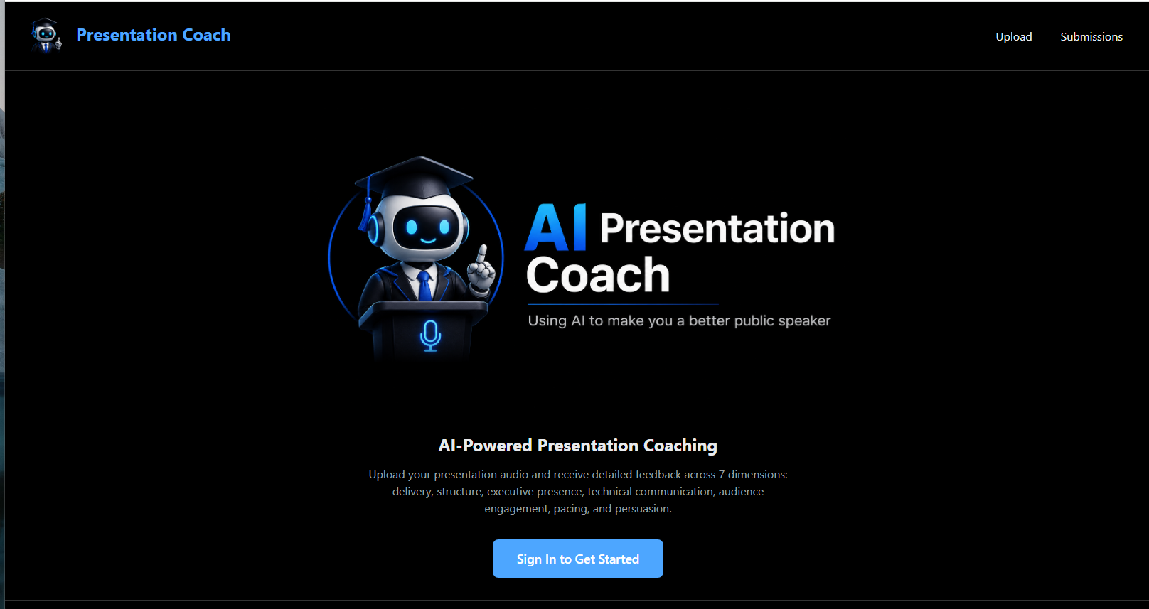
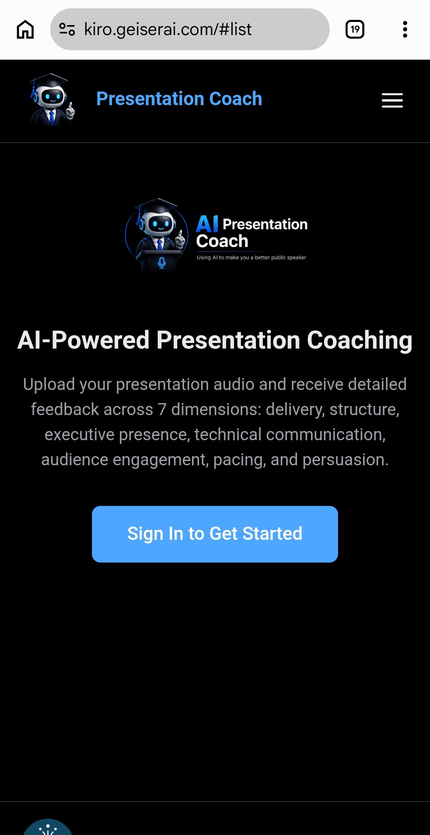
Responsive Web App
Web
Mobile

Slide 3
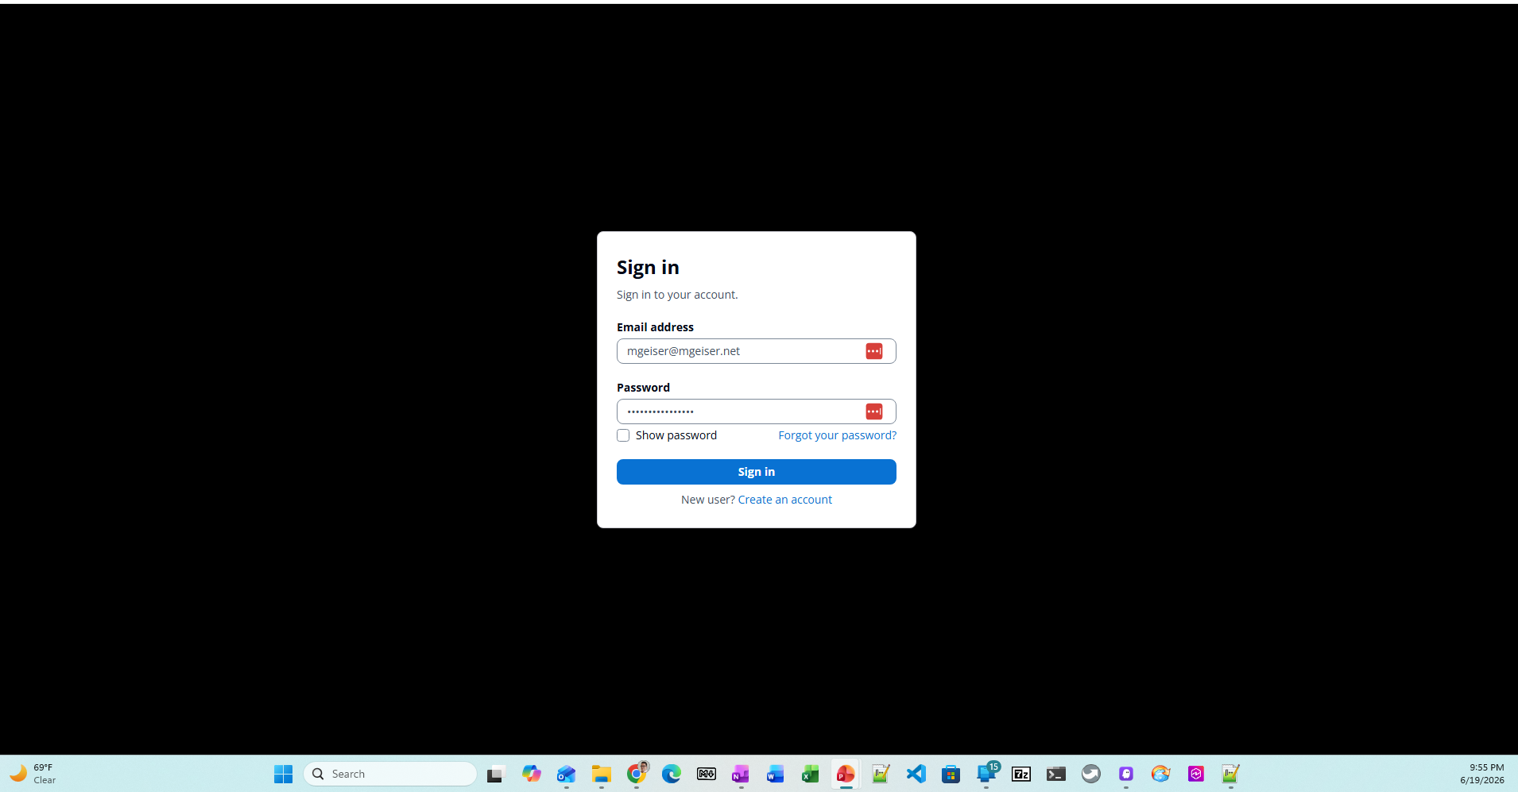
Cognito Based User IAM
Groups:
Users
Administrators
Other Cognito Functions
User Signup
Password reset
Password recovery
MFA not implemented in MVP

Slide 4
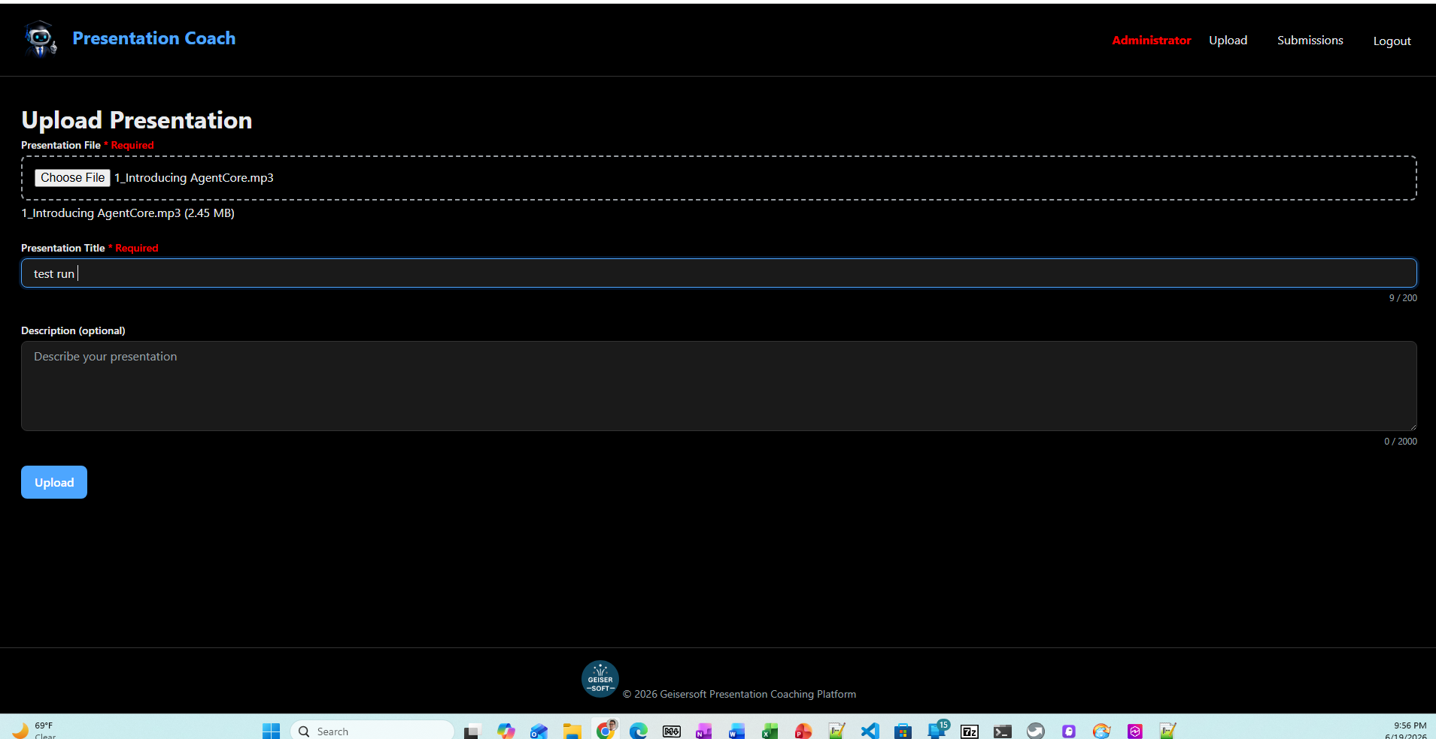
Audio File Upload
Features
File picker
Title
Description
Video File upload on roadmap

Slide 5
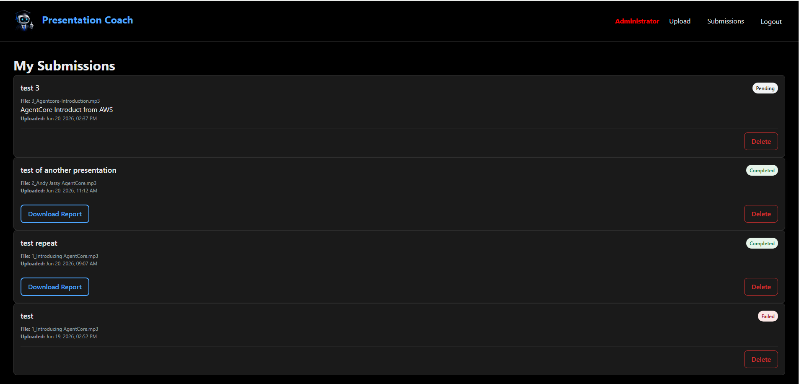
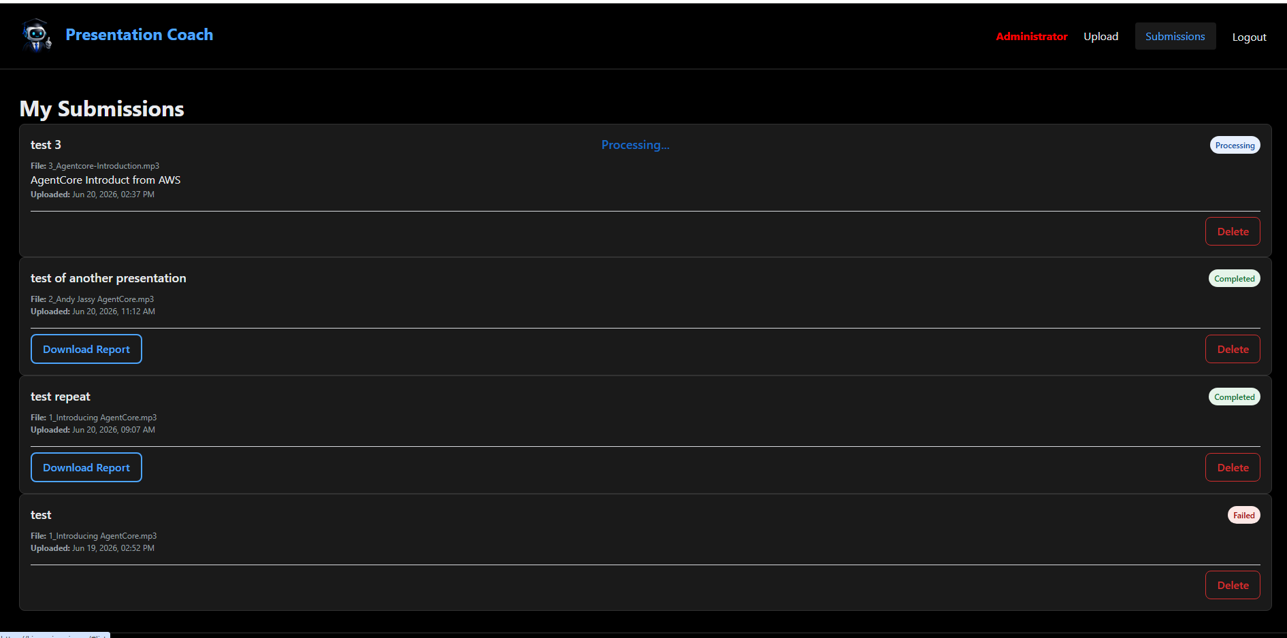
Processing
Features
Multiple steps
User updates

Slide 6
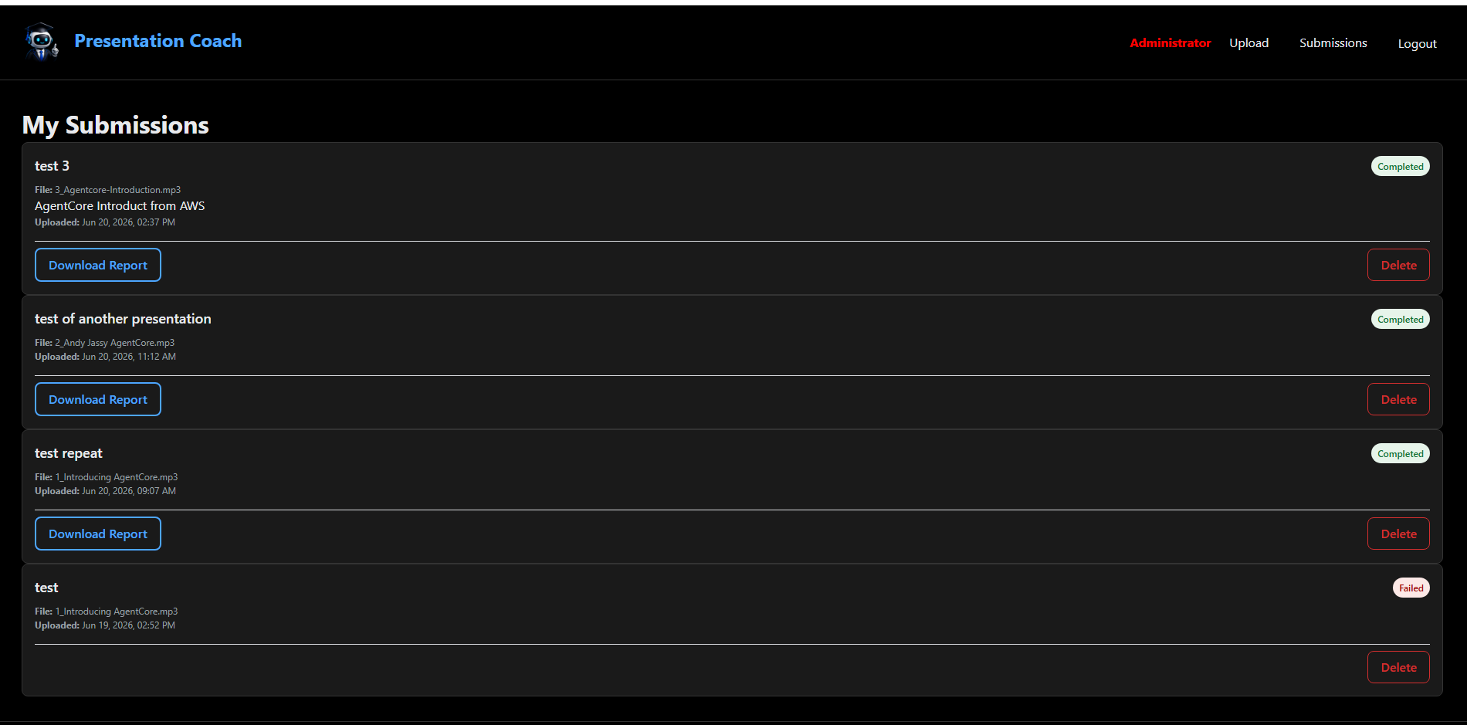
Ready to Read
Features
Current status of analysis
Data entered by User displayed
Download report link
Delete link
Notes:
After completed and will report is being created, the My Submissions page throws a 500 error

Slide 7
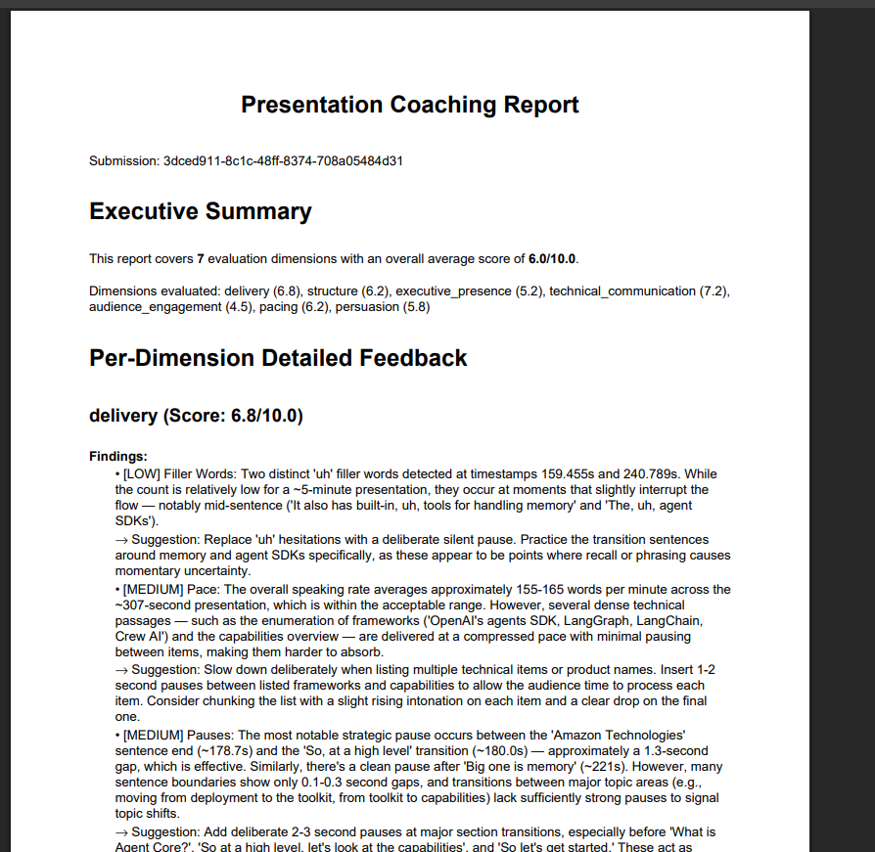
The Report
Features
Detailed feedback (10 – 13 Pages) across 7 dimensions:
Delivery
Structure
Executive presence
Technical communication
Audience engagement
Pacing
Persuasion

Slide 8
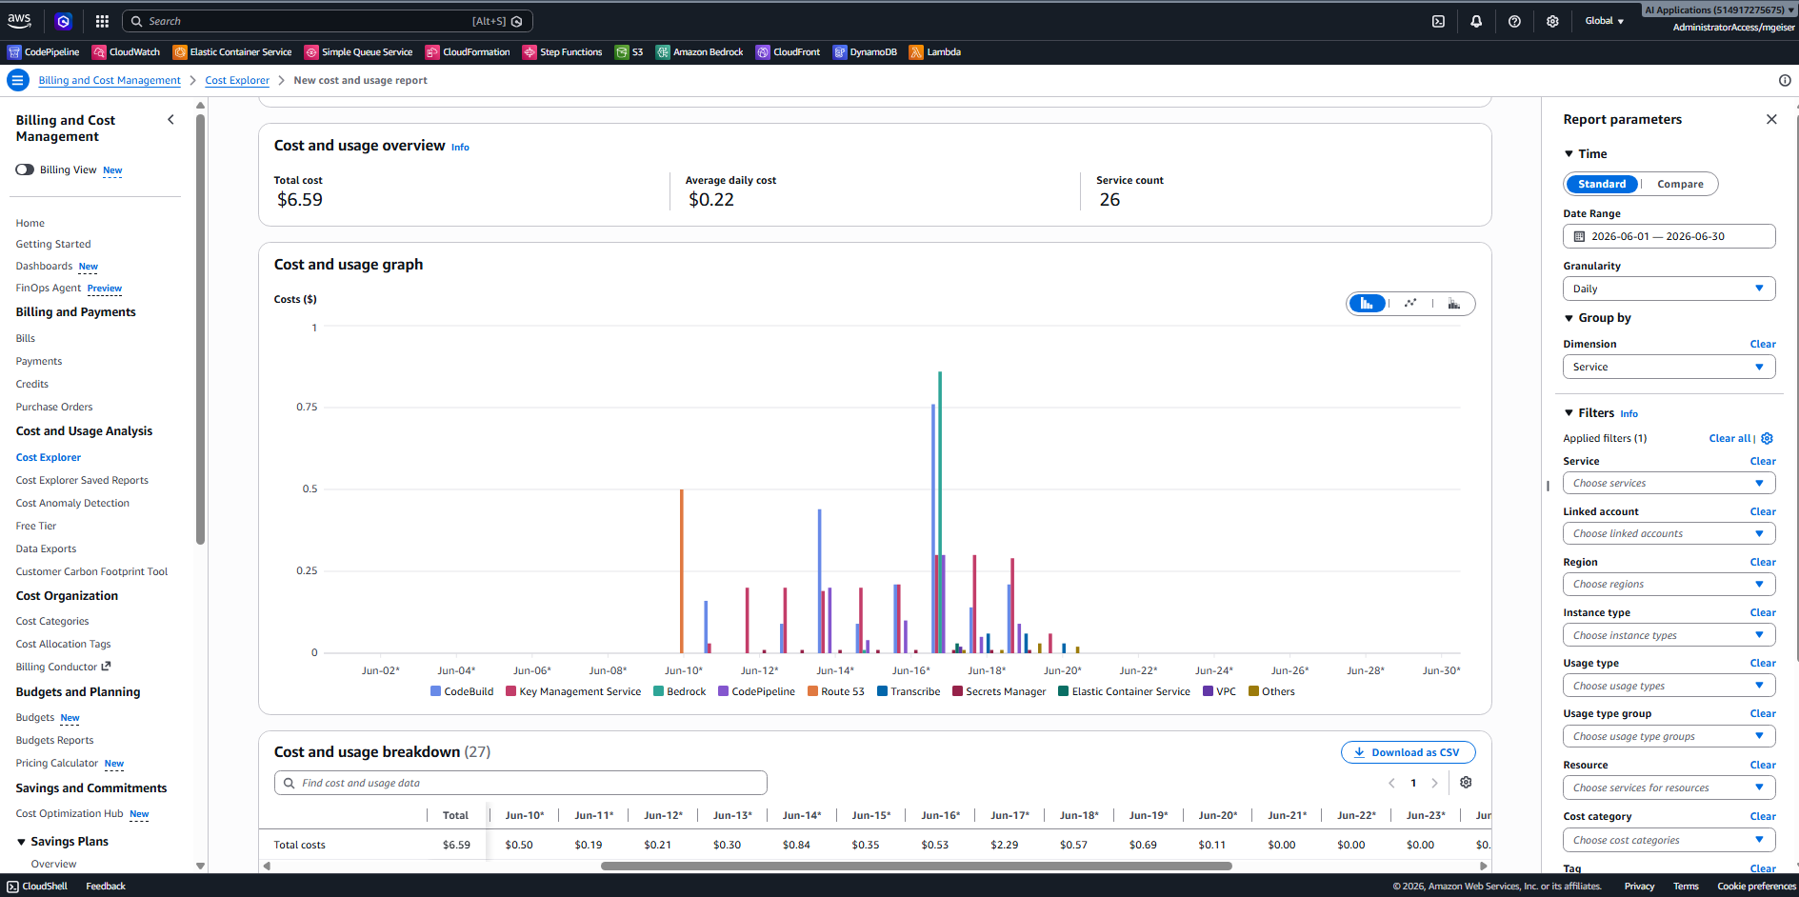

Development Costs
Features
Total costs of the development
AWS Account: $6.59
Kiro AI-DLC: 1355 Credits ($27.10)

Slide 11
Web App SPA and Backend
Ask
Are VPC Endpoints used between AOI Gateway and Lambdas
Are Interface VPC Endpoints used between Lambdas and DynamoDB and S3?
Are Lambdas full insolated from AZ failures?
Where is SQS?
Where is SNS?
us-east-1
VPC
Amazon Cognito
SQS
SNS
API
Gateway
Interface VPC
Endpoint
HTTP API
Traffic
WAF
SPA Web
Traffic
CloudFront
DynamoDB
S3
WAF
NLB
NAT Gateway
CloudFront
ALB
IGW
API Gateway
SSM Session
Manager
VPC Endpoint &
VPC Links

